Slide 1
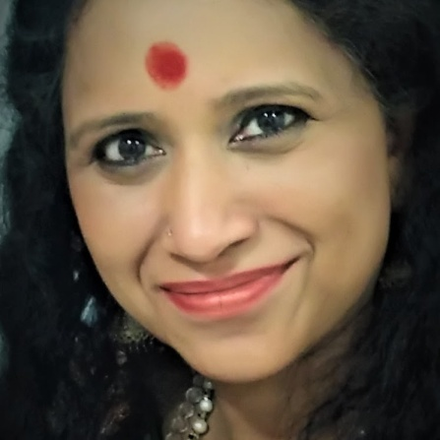

Effects of
Sadhana Yoglakshmi’s chants on the human biofield
Notes:
Check his title Dr? Prof?
https://www.lifepositive.com/the-wonders-of-energy-medicine/
file:///C:/Users/Sadhana/Downloads/Effects%20of%20prayer%20and%20forgiveness%20on%20the%20human%20biofield.pdf
file:///C:/Users/Sadhana/Downloads/Effects%20of%20prayer%20and%20forgiveness%20on%20the%20human%20energy%20field.pdf
https://biofieldviewer.com/products/biofield-viewer-4-0
http://www.biofieldsciences.com/about.html

Slide 2
Research on FIVE MINUTE Forgiveness Prayer by SADHANA YOGLAKSHMI by team of researchers worked with Prof Dr. Thornton from MIT , who works on Bio Field Scans.
They did the Live Scan and the Report is as below. It immediately improved the RESPIRATORY Tract and IMMUNITY System's Energy.

Slide 3
Effect of 5 Minute Forgiveness Prayer in voice of Sadhana Yogalakshmi
Before
BEFORE
AFTER
The energy flow in the respiratory system and immune system was elevated to their highest optimal level (4.66/5 x 10 -2 joules) and (4.36/5 x 10 -2 joules) respectively
Immune system has optimum energy (4.31/5 x 10 -2 joules)
The stress levels had a slight reduction (2.33/2.5)
-2
Elevated to Highest Optimum Level
-2
(3.77/5 x 10
joules)
(4.66/5 x 10 joules)
Respiratory system
-2
-2
Immune system
(4.31/5 x 10
joules)
Elevated to Highest Optimum Level
(4.36/5 x 10 joules)
Stress levels
2.43/2.5
2.33/2.5
Slight reduction
Notes:
e energy flow in the respiratory system and immune system was elevated to their highest optimal level (4.66/5 x 10 -2 joules) and (4.36/5 x 10 -2 joules) respectively. The stress levels had a slight reduction as well. (2.33/2.5)

Slide 4
Let’s Explore the details

Slide 5
One has to note that the following experiments were conducted on one participant. Due to the worldwide crisis, the center of Bio-field Science conducts emergency and quick test to investigate the benefit of two sacred chants.

Slide 6
Background - Effects of music
Research pointed out that “listening to music is one of the most rewarding and pleasurable human experiences”. [1]
Music appears to enhance mood and be stress-relieving by involving the reward system[1]
Music-evoked emotions can modulate activity in virtually all limbic and paralimbic brain structures, which are linked to many physiological systems including immune system and endocrine system. [2]
Notes:
[1] V.Menon and al. (2005) The rewards of music listening: Response and physiological connectivity of the mesolimbic system
[2] Stefan Koelsch and al. (2010) Towards a neural basis of music-evoked emotions.

Slide 7
Background – Effect of music
Musical activity leads to immune system reinforcement. Results suggest that active participation in musical activity produces a greater effect on the immune system than passive participation [3]
Notes:
[3] Dawn Kuhn and al. (2002) The Effects of Active and Passive Participation in Musical Activity on the Immune System as Measured by Salivary Immunoglobulin A (SlgA).

Slide 8
“The Sankirtans are an effective form of yoga or spiritual discipline, necessitating intense concentration, absorption in the seed thought and sound. Because man himself is an expression of the Creative Word, sound exercises on him a potent and immediate effect. Great religious music of East and West bestows joy on man because it causes a temporary vibratory awakening of one of his occult spinal centres (chakras). In those blissful moments a dim memory comes to him of his divine origin.”
Autobiography of a Yogi
Sri Sri Paramahansa Yogananda

Slide 9
Introduction
What is the human biofield?

Slide 10
What is human biofield?
“Human biofield consists of aura and seven major chakras.
The sanskrit meaning for the word chakra is "wheel of light".

Slide 11
What is human biofield?
These subtle energy centers are located at the branching of the nervous systems. The seven major chakras play a major role in the maintaining the harmony of the human body. Each energy center is linked to a physiological endocrine gland via nerve plexes and directly affects the gland connected to it.

Slide 12
What is human biofield
Each gland releases and absorbs certain hormones which are responsible for all emotional states. In turn, this has a strong influence on the psychological functioning of the mind.” [5]

Slide 13
Experiment 1
Effects of Forgiveness Payer on the human biofield

Slide 14
Procedure
The energetic homeostasis of the participant was measured using an advanced Electro-Photonic Imaging camera (EPI/GDV)
The procedure was performed before listening to forgiveness prayer and after 5min listening.
Notes:
A small test has been conducted with analysis of a personal energetic homeostasis by measuring energy fields using an advanced Electro-Photonic Imaging camera (EPI/GDV) to measure the subtle changes in the vitality of the human biofield after listening to the forgiveness prayer for 5mins.

Slide 15
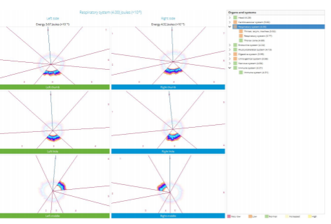
Results – before listening

Slide 16
Results – before listening
Low energy flow in the respiratory system (3.77/5 x 10 -2 joules)
Immune system has optimum energy (4.31/5 x 10 -2 joules)
The emotional stress levels were high (2.43/2.5)
Notes:
s low energy flow in the respiratory system (3.77/5 x 10 -2 joules) and immune system has optimum energy (4.31/5 x 10 -2 joules). The emotional stress levels were high (2.43/2.5).

Slide 17
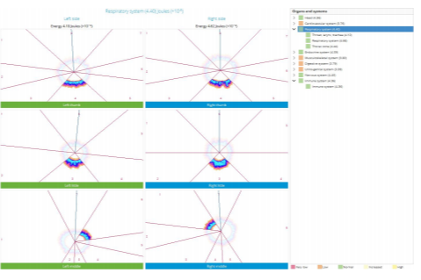
Results – After 5min listening

Slide 18
Results – After 5min listening
The energy flow in the respiratory system and immune system was elevated to their highest optimal level (4.66/5 x 10 -2 joules) and (4.36/5 x 10 -2 joules) respectively
Immune system has optimum energy (4.31/5 x 10 -2 joules)
The stress levels had a slight reduction (2.33/2.5)
Notes:
e energy flow in the respiratory system and immune system was elevated to their highest optimal level (4.66/5 x 10 -2 joules) and (4.36/5 x 10 -2 joules) respectively. The stress levels had a slight reduction as well. (2.33/2.5)

Slide 19
Experiment 2
Effects of Sahaj Shuddhi on the human biofield

Slide 20
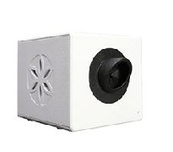
Procedure
The gas-discharge visualization ( or bioelectrogaphy) of the fingers’participant were recorded using Bio-well device
It consists of a visual or instrumental observation of the glow of a gas discharge that appears near the surface of the fingers when it is placed in an electric field of high intensity.
The glow of a person's finger is analysed using computer vision and machine learning.
The type of gas discharge images changes with a change in the human health status. The energy status of a person influences the spectrum of glow. Gas discharge images of the fingers of a person allow us to assess the general level of its physiological activity.
Fig.1 Bio-well.
Notes:
The following research was conducted using a device called Bio-Well. It is an advanced electrophotonic imaging device that is based on a principle known as “Kirlian effect" . It is understood as a visual or instrumental observation of the glow of a gas discharge that appears near the surface of the object under study when it is placed in an electric field of high intensity. Therefore, scientific terms are gas-discharge visualization or bioelectrography .The subject puts a finger between the two electrodes. One of the electrodes is flat, and photographic paper is placed on it. An alternating high-frequency high voltage is supplied at electrodes. The finger near the flat electrode begins to glow with a violet blue glow, which is fixed on the photo paper. The subject almost does not feel anything during discharge, since the current of high frequency, due to the skin effect, flows over the surface of the finger. The glow of a person's finger is analysed using computer vision and machine learning. The type of gas discharge images changes with a change in the human health status. The energy status of a person influences the spectrum of glow. Gas discharge images of the fingers of a person allow us to assess the general level of its physiological activity. The intensity of the discharge glow and its area, as well as its fractal properties, are usually estimated in diagnostics and research of human biofield.

Slide 21
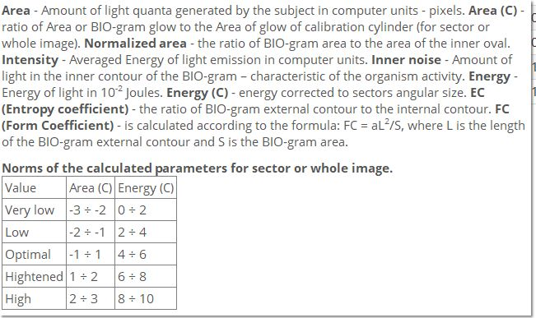
Fig.2 Parameters for analysing the Bioelectrograms.

Slide 22
Procedure
Bioelectrograms baseline were recorded when the subject started listening to Sahaj Shuddi prayer and entered into a meditative state
The second test was conducted after listening to Sahaj Shuddi prayer for 30min
A third test was performed after 30minutes from the second test to observe the energetic trend
Notes:
The Bioelectrograms were recorded as a baseline and the subject started listening to
sahaj shuddhi prayer and entered into a meditative state.
● The second test was conducted after listening to the sahaj shuddhi prayer for 30mins. It
was observed that the energy in the immune system was lower than optimal in the

Slide 23
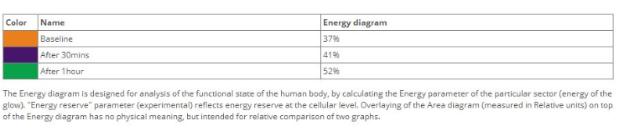
Comparison of energy reserve scores after merely listening to 30 mins Sahaj Shuddhi without knowing much about the meditation in detail.
Color | Name | Energy Diagram
 | Baseline | 37%
 | After 30 Mins | 41%
 | After 1 Hour | 52%
Fig 4. Comparison of energy reserve scores.

Slide 24
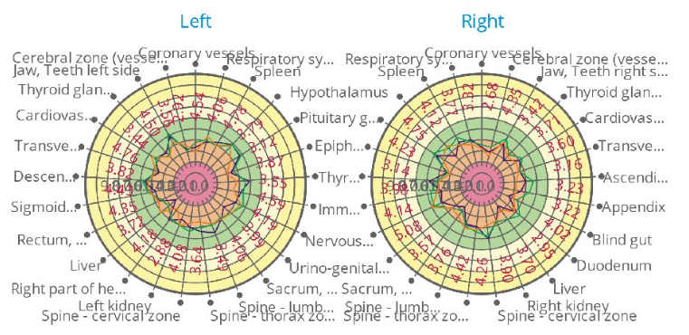
Results – Energy diagrams

Slide 25
The Energy diagram is designed for analysis of the functional state of the human body, by calculating the Energy parameter of the particular sector ( energy of the glow). "Energy reserve" parameter (experimental) reflects energy reserve at the cellular level. Overlaying of the Area diagram (measured in Relative units) on the top of the Energy diagram has no physical meaning , but intended for relative for relative comparison of two graphs.

Slide 26
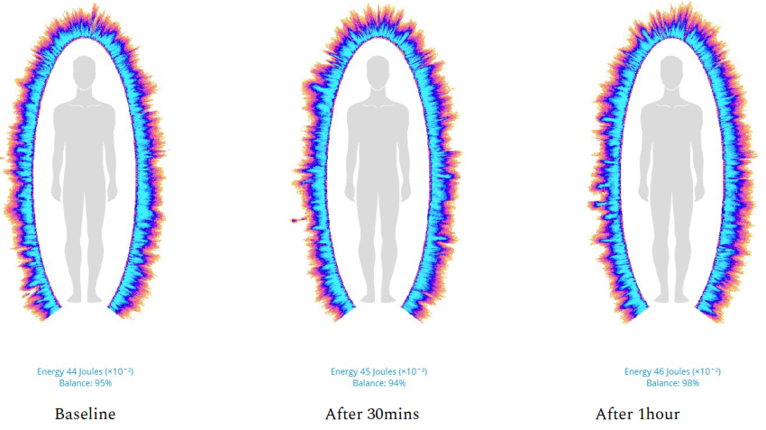
Results – Overall rating of the bioelectrographic test
Notes:
overall rating of the combined
bioelectrographic

Slide 27
Results
The energy in the immune system was lower than optimal in the baseline (3.84/5 x 10​-2​ joules) which improved to optimal state (4.06/5 x 10​ joules) after 30 minutes.
The energy in the immune system has further increased to the highest optimal (4.66/5 x 10​ joules).
Notes:
It was observed that the energy in the immune system was lower than optimal in thebaseline (3.84/5 x 10​-2​ joules) which improved to optimal state (4.06/5 x 10​ joules) after30 minutes.
It was observed that the energy in the immune system has further increased to the
highest optimal (4.66/5 x 10​ joules). The overall rating of the combined
bioelectrographic baseline test was 95% and it was improved to 98% in the third test.
The overall vitality of the energy field also increased form 37% in the baseline to 52% in
the final test.

Slide 28
Results
The overall rating of the combined bioelectrographic baseline test was 95% and it was improved to 98% in the third test.
The overall vitality of the energy field also increased form 37% in the baseline to 52% in the final test
Notes:
It was observed that the energy in the immune system was lower than optimal in thebaseline (3.84/5 x 10​-2​ joules) which improved to optimal state (4.06/5 x 10​ joules) after30 minutes.
It was observed that the energy in the immune system has further increased to the
highest optimal (4.66/5 x 10​ joules). The overall rating of the combined
bioelectrographic baseline test was 95% and it was improved to 98% in the third test.
The overall vitality of the energy field also increased form 37% in the baseline to 52% in
the final test.

Slide 29
Conclusion
It can be concluded that listening to the sahaj shuddhi and forgiveness prayer has positive effects on improving the state of coherence in the human biofield and thereby benefiting the mental health and physical health
Notes:
It can be concluded that listening to the sahaj shuddhi prayer has positive effects on improving the state of coherence in the human biofield and thereby benefiting the mental health and physical health

Slide 30
References
V.Menon and al. (2005) The rewards of music listening: Response and physiological connectivity of the mesolimbic system
Stefan Koelsch and al. (2010) Towards a neural basis of music-evoked emotions.
Dawn Kuhn and al. (2002) The Effects of Active and Passive Participation in Musical Activity on the Immune System as Measured by Salivary Immunoglobulin A (SlgA).
“Autobiography of a Yogi” Sri Sri Paramahansa Yogananda
http://www.biofieldsciences.com/
Notes:
http://www.biofieldsciences.com/
[1] V.Menon and al. (2005) The rewards of music listening: Response and physiological connectivity of the mesolimbic system
[2] Stefan Koelsch and al. (2010) Towards a neural basis of music-evoked emotions.
Autobiography of a Yogi Sri Sri Paramahansa Yogananda

Slide 31
References
Alexandrova, R., Fedoseev, G., & Korotkov, K. (2004). Analysis of the Bioelectrograms of Bronchial Asthma Patients, 75-82.
B. Williams, How does gas discharge visualization technique assess a body? Emerging models of energy and control in biophysics and physiology, in Proceedings of the 18th IEEE Symposium on Computer-Based Medical Systems, pp. 446-448,Saint Petersburg, Russia,June 2005
Korotkov KG, Matravers P, Orlov DV, Williams BO. Application of electro photon capture (EPC) analysis based on gas discharge visualization (GDV) technique in medicine: A systematic review. J Altern Complement Med 2010;16:13-25.13
Korotkov KG. Human Energy Field: Study with GDV Bioelectrography. Fair Lawn, NJ.Backbone Publishing Co.; 2002.14
CohlyH,Kostyuk,IsokpehiR,Rajnarayanan.Bioelectrographic method of preventive healthcare.In:First AnnualORNLBiomedicalScienceandEngineering Conference; 2009. p. 1-4.
Notes:
CohlyH,Kostyuk,IsokpehiR,Rajnarayanan.Bioelectrographic method of preventive healthcare.In:FirstAnnualORNLBiomedicalScienceandEngineering Conference; 2009. p. 1-4.

Slide 32
References
Lutz A, Greischar LL, Rawlings NB, Ricard M, Davidson RJ. Long-term meditators self-induce high-amplitude gamma synchrony during mental practice. Proc Natl Acad Sci U S A 2004 16;101:16369-73
E. V. Krizhanovskyy, S. A. Korotkina, and K. G. Korotkov, Role of the human central nervous system in the formation of the glow of the skin in high intensity electromagnetic ﬁeld, in Proceedings of the IXth Annual International Congress Science,Information, Spirit, Saint Petersburg, Russia, July 2005.
K. Priyadarsini, P. Thangam, and S. Gunasekaran, Kirlian Images in Medical Diagnosis: A Survey in International Conference on Simulations in Computing Nexus, ICSCN, 2014, pp. 5-7.
I. Ignatov, O. Mosin, and C. Stoyanov, Fields in Electromagnetic Spectrum Emitted from the Human Body. Applications in Medicine. Journal of Health, Medicine and Nursing, vol. 7, pp. 1-23, 2014.
Notes:

K. Priyadarsini, P. Thangam, and S. Gunasekaran, Kirlian Images in Medical Diagnosis: A Survey in International Conference on Simulations in Computing Nexus, ICSCN, 2014, pp. 5-7.

I. Ignatov, O. Mosin, and C. Stoyanov, Fields in Electromagnetic Spectrum Emitted from the Human Body. Applications in Medicine. Journal of Health, Medicine and Nursing, vol. 7, pp. 1-23, 2014.

